Slide 1
An Introduction to Cyclotrons
Jim Ball
March 2004
Notes:
Before beginning to describe the details of what makes a cyclotron tick, I want to comment briefly on why someone would want to make one in the first place.
To address that, I want to first touch on the topic of dimensionality.

Slide 2
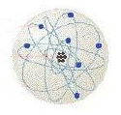
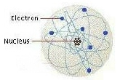
Dimensionality
0.001 in typical “tight” machining tolerance
0.001 cm (10⁻³ cm) → now divide this by 100,000
0.00000001 cm = 10⁻⁸ cm = 1 Å this is the world of the atomic physicist, the chemist, and the biologist → now divide this by 100,000
10⁻¹³ cm = 1 F this tiny core inside the atom is the world of the nuclear physicist
Notes:
In the day-to-day world in which we live, we tend to think of dimensions in units of inches, feet, yards, or miles. These are the units we have a feeling for. In fact, when we have something made in the machine shop, its not unusual for us to specify tolerances to a thousandth of an inch. A very thin sheet of paper is about this thick.
Within a factor of 2, this is a dimension of 10⁻³ cm.
If we know divide this by 100,000, we get 10⁻⁸ cm. This is an important dimension, because this is roughly the size of an atom with its electron cloud. This unit of measure we call an Ångstrom, and it is the dimension of the world where the atomic physicist, the chemist, and the biologist live. An Ångstrom is about the limit of our ability to “see” objects with present day scanning electron microscopes.
Now if we divide our Ångstrom by another factor of 100,000 we reach 10⁻¹³ cm. This is another special dimension. It is of order the size of the atomic nucleus, We call this a Fermi and it is the dimension of the world of the nuclear physicist.
So, how does the nuclear physicist examine the nucleus? What sort of a tool does he need?

Slide 3
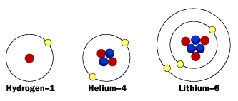
The “Tools” of Nuclear Physics
The nuclei of simple atoms
Stripped of one or more electrons and accelerated to energies greater than the strong nuclear force that holds the nucleus together
Notes:
Basically, the tool needs to be of the same dimension as the object being studied, and needs to be strong enough to take the object apart.
One of the more common tools used by the nuclear physicist is the nucleus of one of the light elements, stripped of its electrons, and then accelerated to energies greater than the strength of the strong nuclear force that holds nuclei together.
The nucleus of the hydrogen atom is simply a proton, and the nucleus of the helium atom is an alpha particle.
Typically, the binding energy of a proton or neutron in an atomic nucleus is of the order of a few MeV.
To impart this amount of energy to our proton or alpha particle requires some sort of particle accelerator.

Slide 4
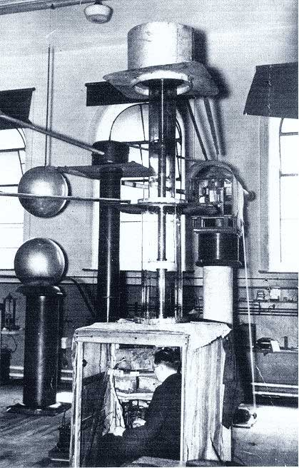
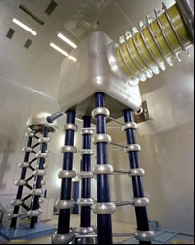
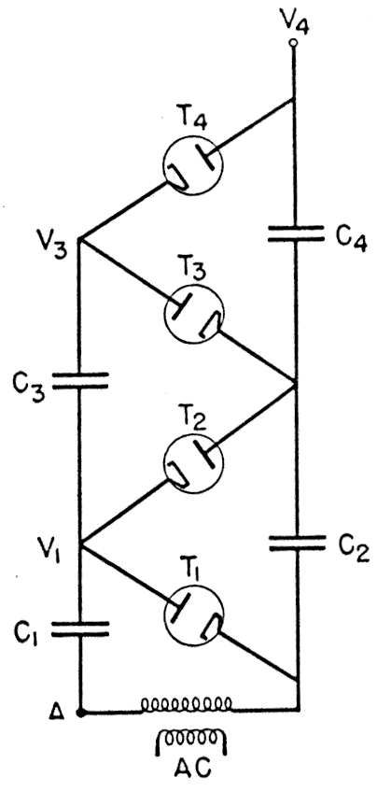
The Early Accelerators
1) The Cockcroft-Walton (circa 1930)
Notes:
The earliest form of particle accelerator was what we call a potential-drop accelerator. In this type of accelerator, a large voltage is generated and the particle is accelerated across this voltage drop.
One of the earliest of this type of accelerator was developed by Cockcroft and Walton. They used a stacked, high voltage rectifier circuit to generate the high voltage. Initially, they were able to accelerate protons to 200 keV.
In 1932, they succeeded in increasing the proton energy to 800 keV and observed the reaction p + Li → α + α. This was the first accelerator induced nuclear reaction.
The middle picture shows this accelerator. It also shows Cockcroft sitting in his “counting room.”
A modern version of this type of accelerator is shown at the right. This is a proton injector at Fermi Lab.
As an historical note, also in 1932 using energetic alpha particles from the decay of polonium to bombard a lithium target, Chadwick discovered a neutral particle of about the same weight as the proton. He named it the neutron.

Slide 5
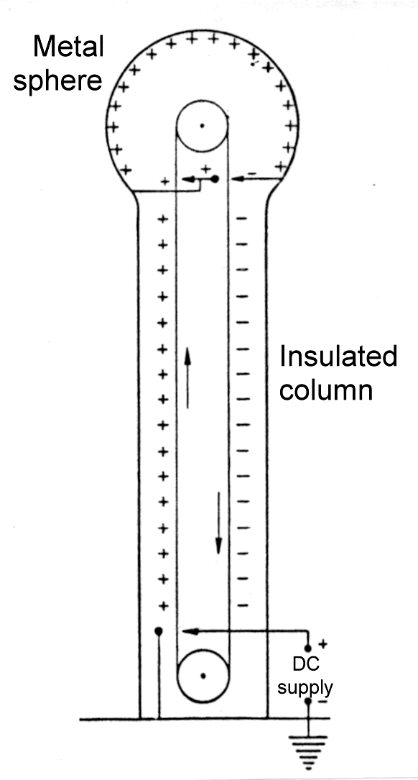
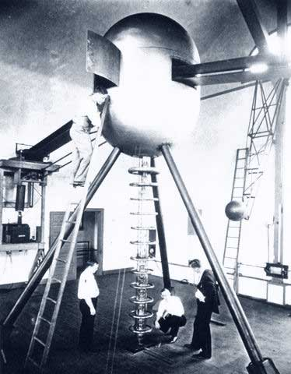
The Early Accelerators
2) The Van de Graaff (1931)
Notes:
In 1931, Robert Van de Graff invented a new type of potential-drop accelerator using static electricity, conveyed on a non-conducting belt, to charge an insulated metallic sphere.
An early version of this machine is shown at the right. Subsequently, a large number of this type of accelerator were produced commercially and became a common research tool at many universities.
A number of larger accelerators of this type continue to operate, with the largest being the 25MV tandem at the Holifield Facility in Oak Ridge.

Slide 6
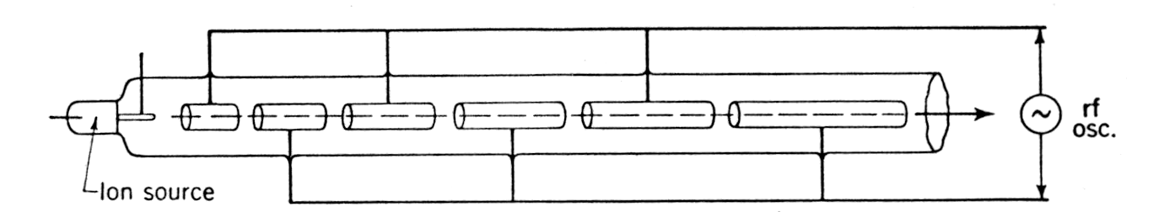
The Early Accelerators
3) The Linear Accelerator
Wideröe (1928) - proof of principle
Sloan and Lawrence (1931) - first working linac
Notes:
A different style of accelerator, is the linear accelerator. Here, instead of using one large voltage drop, the idea is to use a relatively small voltage difference, but to apply it many times to the particle.
This idea actually appeared in 1928, along with a proof of principle, in a thesis by Wideröe. However, it wasn’t until 1931 that it was effectively demonstrated.
When Lawrence accepted a position at Berkeley, he took one of his graduate students, Sloan, with him. Lawrence had come across Wideröe’s paper and decided to have Sloan build an accelerator based on this idea.
Sloan’s accelerator consisted of 30 electrodes, and the rf system produced 33 kV peak-to-peak at a frequency of 10 MHz. The entire system was about 3 feet long. They were successful in accelerating Hg+ to an energy of 1 MeV. (Later went to 1.3 MeV)
This machine was tailored for Hg+ and the first electrode was ~1 cm in length. For protons, this would need to increase to ~5 cm. To accelerate protons to 1 MeV, the 30 electrodes would stretch almost 50 feet.
Lawrence realized that to get the energies he was interested in would require a very long accelerator!

Slide 7
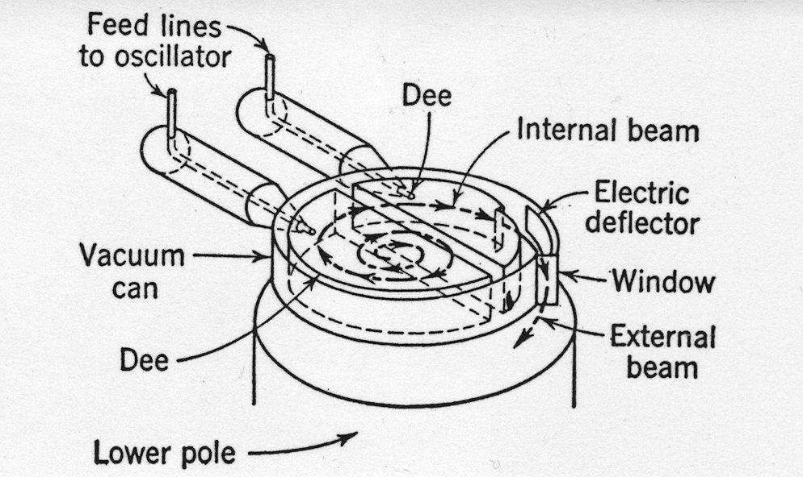
The Early Accelerators
4) The Cyclotron
E. O. Lawrence (1932)
Notes:
To address this, Lawrence decided to use the linear accelerator concept, but see if you can wrap it up in a magnetic field.
Here the many electrodes would be replaced by two, D-shaped electrodes placed in the gap of a magnet. The charged particles are constrained by the magnetic field to follow circular paths. Thus a particle will receive two accelerations per turn.
The basic parts of this type of accelerator are then the ion source, the rf/Dee system, the magnet, and a vacuum enclosure.

Slide 8
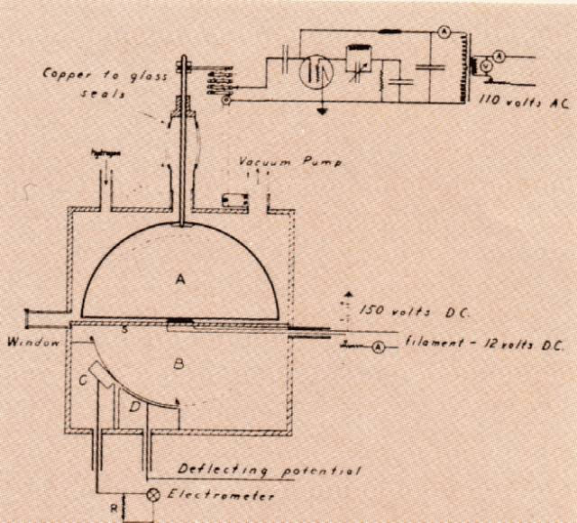
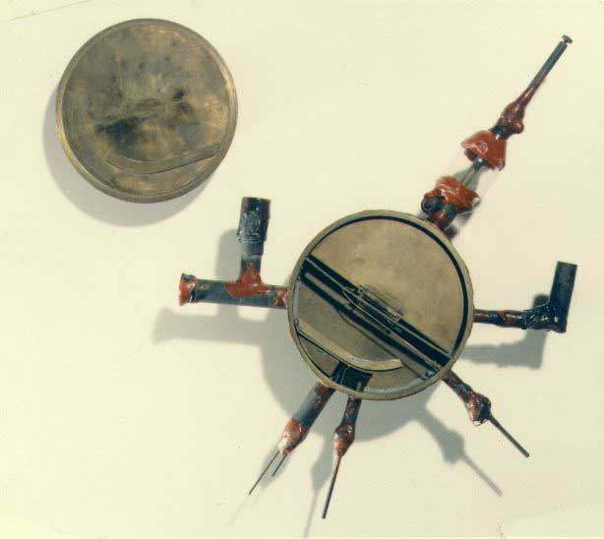
Notes:
The sketch of Lawrence’s concept, from his notebook is shown at the left. At the right is a picture of his original device. The diameter is about 4½ inches.
Note that there is only one Dee. Rather than accelerating the particles across a gap between two Dees that oscillate positive and negative with respect to each other, this version accelerates the particles across a gap between ground and a Dee that oscillates positive and negative with respect to ground. This places more importance on the voltage holding capability of the Dee structure, but may simplify the physical construction. This single-Dee option is the one that is employed in ORIC.

Slide 9
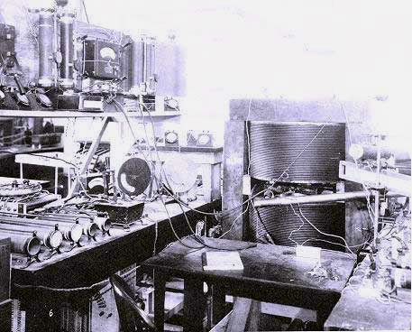
Notes:
Here’s what the assembled accelerator looked like with the Dee structure and vacuum enclosure positioned inside the gap of a borrowed electromagnet and hooked to the rf system at the left.
This was the first operating model and it successfully accelerated H₂+ ions to 80 keV. The ions traversed 40 turns to reach this energy.
Lawrence dubbed his accelerator the cyclotron.
In order to understand the details of how the cyclotron works, we need to take a brief detour into understanding electromagnets.

Slide 10
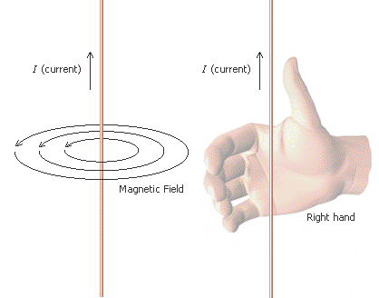
Electromagnets
Right-hand Rule #1
Wrap fingers around wire with thumb pointing in direction of formal current (+ to -)
Magnetic field lines flow in direction of fingers
Notes:
In working with electromagnets and magnetic fields, there are two right-hand rules that you need to remember.
The first rule deals with the observation that a current flowing through a conductor develops a magnetic field whose flux lines travel in a plane perpendicular to the conductor.
Right-hand rule #1 is that if you wrap the fingers of your right hand around the conductor with your thumb pointing in the direction of formal current flow (formal current is defined as flowing from the + terminal to the – terminal), then the magnetic field lines flow in the direction that your fingers point.

Slide 11
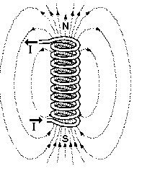
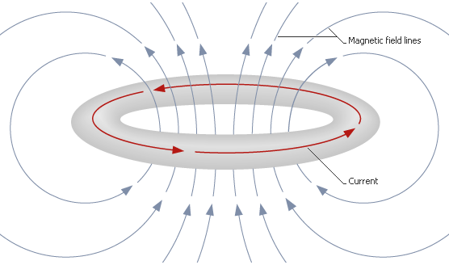
Electromagnets
Solenoid Coil
Simple Coil
Notes:
Now if we form the conductor into a loop, then we see that by using right-hand rule #1 we can determine that the loop produces a magnetic field in the center of this loop. We can also determine in which direction the magnetic field lines flow.
We can increase the strength of this magnetic field by increasing the number of turns as shown at the right. This coil configuration is referred to as a solenoid.

Slide 12
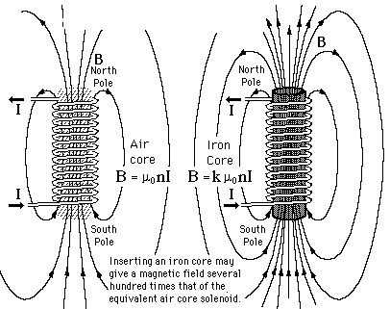
Electromagnets
Notes:
The diagram at the left shows the formula for calculating the strength of the magnetic field produced by a solenoid. Here μ₀ is the “permeability” of air, n is the number of turns in the solenoid and I is the current in amps.
One way to make a big increase in the strength of the field produced by the solenoid is to place an iron core inside the solenoid coil. Actually, any ferromagnetic material will work, but iron is the most common. Now the formula for the strength of the field is modified by an additional multiplier, k, which is the “relative permeability” of the core material.
The ferromagnetic property of iron results in the small magnetic domains in the iron lining up with the smaller driving magnetic field from the coil to multiply the overall field by factors of tens to hundreds.
Now to convert this solenoid to a practical laboratory magnet we essentially cut it in half.

Slide 13
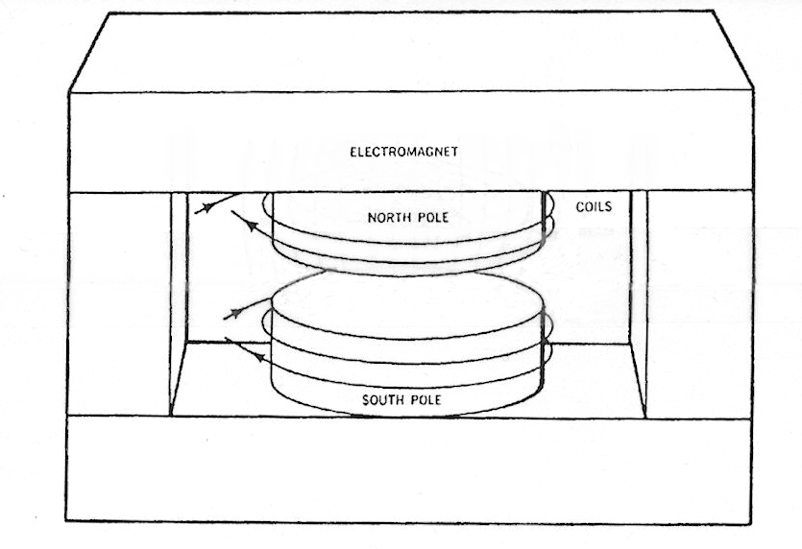
Typical Electromagnet
Good design will have cross-section of yoke about 1.2 times cross-section of pole, and will operate at fields below point where the magnetic field in the iron begins to saturate.
Notes:
We separate the two halves to create a gap, and then surround the split solenoid with an iron yoke that serves to confine the return flux lines within the area occupied by the yoke.
In this manner we keep the return field from spreading out into the surrounding space and disturbing other equipment.
(You can use right-hand #1 rule here to verify the direction of the magnetic field lines shown in the magnet gap.)

Slide 14
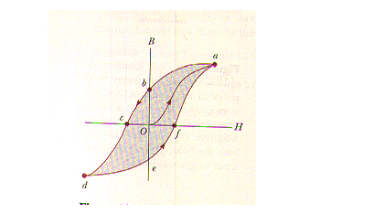
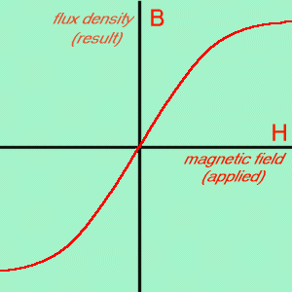
Saturation and Hysteresis
Notes:
The achievement of high magnetic fields by linig up the magnetic domains in the iron comes at the price of a couple of side effects that you need to be aware of.
The first is saturation. As you increase the current in the coils, more and more of the magnetic domains in the iron are aligned. Eventually, enough are aligned that it takes more and more current to align the remaining domains. Thus, the curve of magnetic field produced versus the driving field (coil current) becomes non-linear, bending over and essentially becoming flat as no more domains are left to be aligned. So you end up with a magnet excitation curve as shown at the left.
The second effect is hysteresis. If you increase the magnet coil current to a certain point and then reduce the current, the magnetic field coming down does not follow the same curve as the magnetic field produced going up. This is caused by the fact that the magnetic domains, once aligned, have a preference to stay in that orientation. So you have something very akin to a backlash in a mechanical system
A consequence of this hysteresis is that in trying to reset a magnet to a previous setting, it is important to follow the same setup procedure as used previously.

Slide 15
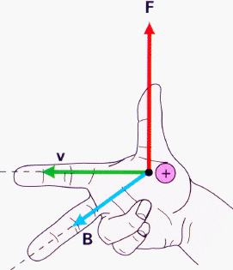
Particle Motion in a Magnetic Field
Right-hand Rule #2
Point index finger in direction of particle travel
Fold down middle finger and point in direction of magnetic field
Thumb points in direction of force on moving particle
Note: This is for a positively charged particle.
Notes:
Now, given that we have produced a magnetic field with our magnet, we need to understand how a charged particle will move in this field.
This brings us to right-hand rule #2.
As shown in the figure, if we have a magnet gap with flux lines flowing from top to bottom, then a particle moving forward would experience a force to the left. At each point along its path the particle will feel this same force, so that eventually the particle will traverse a circular orbit in the magnetic field.
So, a charged particle will traverse a closed circular path in the magnetic filed as long as its energy remains constant. In this case the right hand rule show us that this orbit is traversed in a counter-clockwise direction.
In the case of a bending magnet, i.e., a magnet too small to contain the particle in a closed orbit, this right-hand rule will tell us in which direction the magnet will steer the particle.

Slide 16
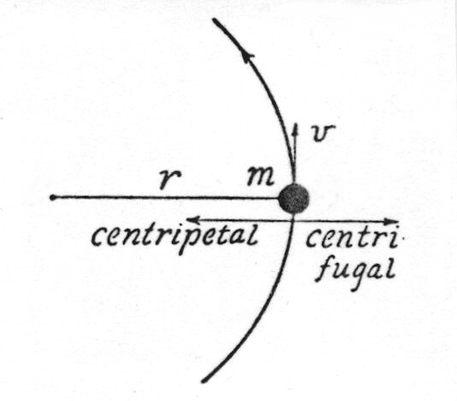
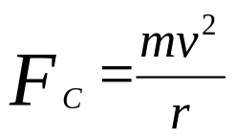

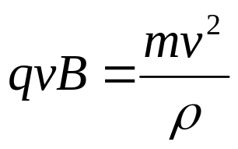


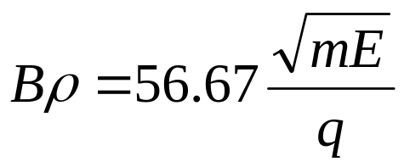
Classical Particle Motion in a Magnetic Field
Magnetic force on particle
Classical centripetal force
set these equal
and rearrange
Since
, we can derive the following useful formula:
where Bρ is in kilogauss-inches.
Notes:
Now let’s take a look at the equations of motion for a particle in a magnetic field. We need to do a little algebra here, but we’ll keep it pretty simple!
The upper left equation is an algebraic restatement of our right-hand rule #2. At the right is the classical equation for the force exerted to confine a moving object to a circular trajectory.
For a particle moving in a circular path in a magnetic field, these two equations must be equal. We can thus easily derive the result that the product of the field, the radius of curvature, and the charge on the particle is equal to the momentum of the particle.
Putting in the appropriate normalizations, we get the handy formula shown on the last line. This is a good formula to commit to memory. From this, if you know the magnet field and the radius of curvature you can calculate the energy of the particle. Or, knowing the radius of curvature of a bending magnet and the energy of the particle, you can calculated what field will be required to transport the particle through the magnet.

Slide 17
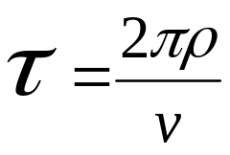
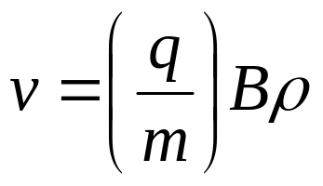
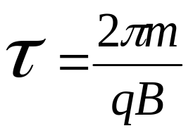
Classical Particle Orbits in a Magnetic Field
Time to complete one orbit will be:
From
we get
Substituting into the first equation gives:
This is the classical cyclotron equation.
Note that the orbit time has no dependence on the radius!!
Notes:
However, for right now, let’s return to the case where we have a particle traveling in a circular orbit in a magnetic field.
We are now in a position to answer Lawrence’s question of “what happens if we wrap a linear accelerator up in a magnetic field?”
First we write down that the time for the particle to complete one turn of the orbit is just the distance (the circumference of the circle) divided by the velocity of the particle.
From our equation for the momentum of the particle (previous slide), we can solve for the velocity and substitute this into the equation for the orbit time.
This is the classical cyclotron equation. Note that the orbit radius appears nowhere in this equation. This means that as the particle increases in energy, the increased path length compensates exactly for the increased velocity and the orbit time becomes constant. Thus, a fixed frequency on the Dee structure will accelerate particles from the center of the magnet until they can no longer be contained by the magnetic field.
It was writing down this equation that made Lawrence realize that this cyclotron concept would work.
This simple equation was worth a Nobel prize!!

Slide 18
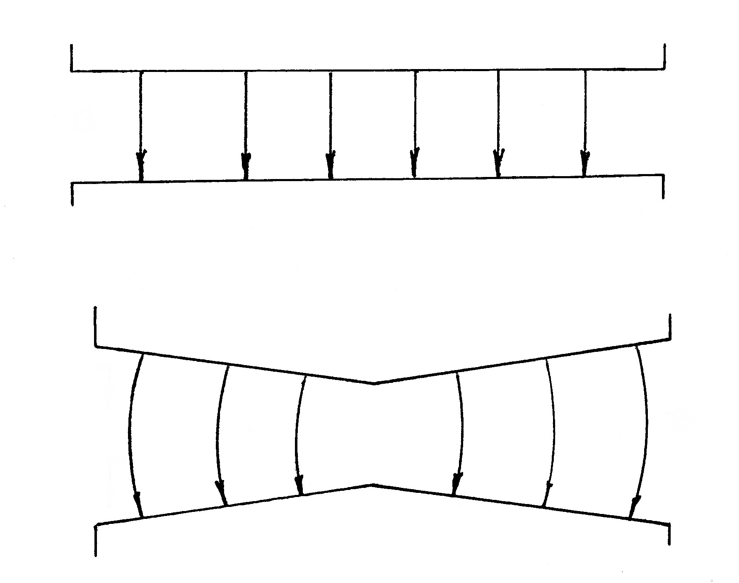
Making a Cyclotron
Case 1: Flat field
Problem – no axial focussing
Case 2: Falling field
Now have axial focussing, but have new problem!
Notes:
However, life is never quite that simple!
If you just take a flat magnetic field for your cyclotron, you find that the particle orbits will tend to migrate towards one or the other of the pole faces and be lost. Nearly every particle will have some vertical component of momentum, and with no restoring force, this migration is inevitable. In addition, in a completely uniform field, there is nothing to keep the orbits centered in magnet. They can easily shift sideways and precess out of the magnet gap.
The solution to this is to introduce a small taper to the magnet pole faces which causes the field to drop off slightly with radius. This causes the flux lines to “bow” slightly and results in a restoring force that keeps the particle orbits centered in the magnet gap.
This cures the focusing problem, but it comes at a price. With a lower field the orbit radius becomes slightly larger and thus the orbit time slightly longer. This increased orbit time means the particle will arrive after the full voltage on the rf has passed, so now it begins to lag in phase and get less and less acceleration each time. This “phase slip” will put a practical energy limit then on this form of the cyclotron.

Slide 19

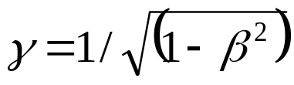

A Little Relativity
Two important definitions:
One way to express effect of relativity:
Example Values for Protons
Ep | β = v/c | m/mo
5 | 0.10 | 1.005
10 | 0.14 | 1.011
20 | 0.20 | 1.021
40 | 0.28 | 1.043
60 | 0.34 | 1.064
75 | 0.38 | 1.080
Notes:
Not only will we be constrained by the “phase slip” in our “classical” cyclotron, but nature adds to this problem with a phenomena that we refer to as “relativistic mass increase.”
One of the tenets of general relativity is that nothing can travel faster than the speed of light. One way to express this limit is to say that the mass of a particle increases with energy (or more precisely its velocity), becoming infinite in mass at the value of the speed of light. (Thus no finite force can accelerate it further.)
This effect is illustrated in the formulas above, and the table illustrates the result of applying these equations to protons.
From this we can see, for example, that for 10 MeV protons, they are traveling at 14% of the speed of light and have and increase of their mass of 1.1%. For 75 MeV protons, the mass increase is up to 8%.
From the formula for orbit time, developed on the previous slide, we see that an increase in the mass of the particle also increases the orbit time, so that this makes the effect of a falling magnetic field even worse.
These two effects then combine to limit the practical energy range of the “classical cyclotron” concept.

Slide 20
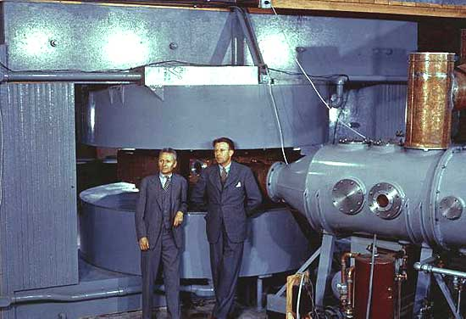
The Classical 60-inch Cyclotron
Typical Performance
E_{p} = 11 MeV
E_{d} = 22 MeV
E_{α} = 44 MeV
Donald Cooksey and Ernest Lawrence at the LBL 60-inch cyclotron.
Notes:
Lawrence’s continuing work on developing the cyclotron concept led in the late 1930’s to the construction of a 60-inch machine at Berkeley, shown in the picture. This machine became operational in 1940 and would reach a proton energy of about 10 MeV.
Later copies of this cyclotron at other institutions achieved slightly higher energies. I worked on the 60-inch cyclotron at the University of Washington and I have listed our energies on the slide as those typical of this generation of cyclotrons.
In the picture, the man standing on the right is Ernest Lawrence.
As an historical note, it was on the cyclotron shown here that in 1941 Glenn Seaborg discovered a new element that he called Plutonium.

Slide 21
“Classical” Cyclotrons at Oak Ridge
The 22-inch - 1948 2 MeV protons
The 44-inch - 1949 5 MeV protons
The 86-inch - 1950 23 MeV protons
The 63-inch - 1952 27 MeV N⁺³
Notes:
After World War II was over, the group of cyclotron people that had come here to build and operate the Calutron mass separation facilities returned to building cyclotrons.
The first machines were built utilizing the magnetic field present in the magnet gaps of one of the Calutron rings. Three gaps were used. The outer gaps were plugged with iron to serve as the magnet pole pieces, and the Dee structure was inserted into the gap between these two poles.
The last of the cyclotrons built in a Calutron gap was the 63-inch cyclotron. This was the first cyclotron built specifically to accelerate heavy ions.
The 86-inch cyclotron was the only one of these machines to be built in a stand-alone configuration. This cyclotron achieved a proton energy significantly higher than any other conventional cyclotron ever built.

Slide 22
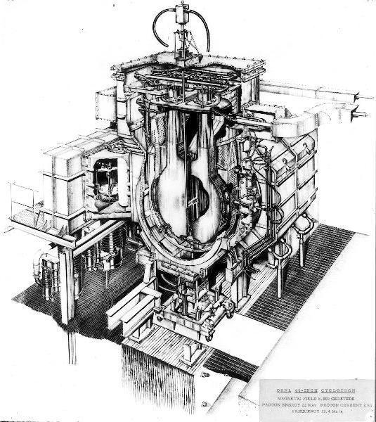
Fighting the Energy Limit of the Classical Cyclotron
1) The brute force approach:
Best example may be the 86-inch cyclotron.
E_{P} = 22 MeV
I_{P} = 2 mA
V (D to D) = 500 kV
Notes:
So, how to we overcome the energy limit of the classical cyclotron configuration?
Well, the most obvious approach is to try brute force. This brings us back to the 86-inch cyclotron.
To keep the particles centered in the median plane of the magnet, the field dropped about 1.6% from the center out to the extraction radius. To minimize the effect of the phase slip which would occur on each turn, the two Dees were run at 250 kV which gave a Dee-to-Dee voltage of 500 kV at each gap crossing. Thus, the nominal energy gain was 1 MeV per turn so that the particle was literally ripped out of the machine in something less that 30 turns.
Note also the very high internal currents that were obtained on this cyclotron. Such currents were used routinely on internal grazing-incidence targets.
While this cyclotron was very successful, it also represents a machine very near the practical limit of this approach to increasing the particle energy in a conventional cyclotron.

Slide 23
Fighting the Energy Limit of the Classical Cyclotron
1) The brute force approach:
- good example is the 86-inch cyclotron at Y-12 (1950)
2) The Variable-Frequency cyclotron:
sometimes referred to as FM cyclotrons or synchrocyclotrons
good example is the 184-inch synchrocyclotron at LBL (1946)
pulsed beam nature results in low intensities
3) The azimuthally varying field (AVF) concept
first suggested by Thomas in 1938
largely ignored until the mid 1950’s
first examples are the 88-inch cyclotron (LBL) and ORIC
Notes:
Another approach to increasing the energy was the variable-frequency cyclotron (sometimes referred to as the synchrocyclotron).
This type of cyclotron is built just like our classical cyclotron except that the rf system is made to be variable. The timing of the change in rf frequency is such that as the particle energy increases and the orbit time increases (due to field fall off and relativistic effects) the rf frequency decreases to keep in step.
This works very well, except that the beam currents are greatly decreased since the rf takes one bunch (in length about 6% of the rf cycle) and accelerates this all the way to extraction. In the meantime, no other bunches are accelerated. Thus, however many turns are required to accelerate the particle to full energy, the classical cyclotron intensity is decreased by a factor of 1 divided by this number.
One of the best examples of the VF cyclotron was the 184-inch machine at LBL which accelerated deuterons to 200 MeV.
A third approach to increasing energy is the AVF concept originally suggested by Thomas in 1938 but largely ignored until the advent of large-scale digital computers in the mid 1950’s.

Slide 24
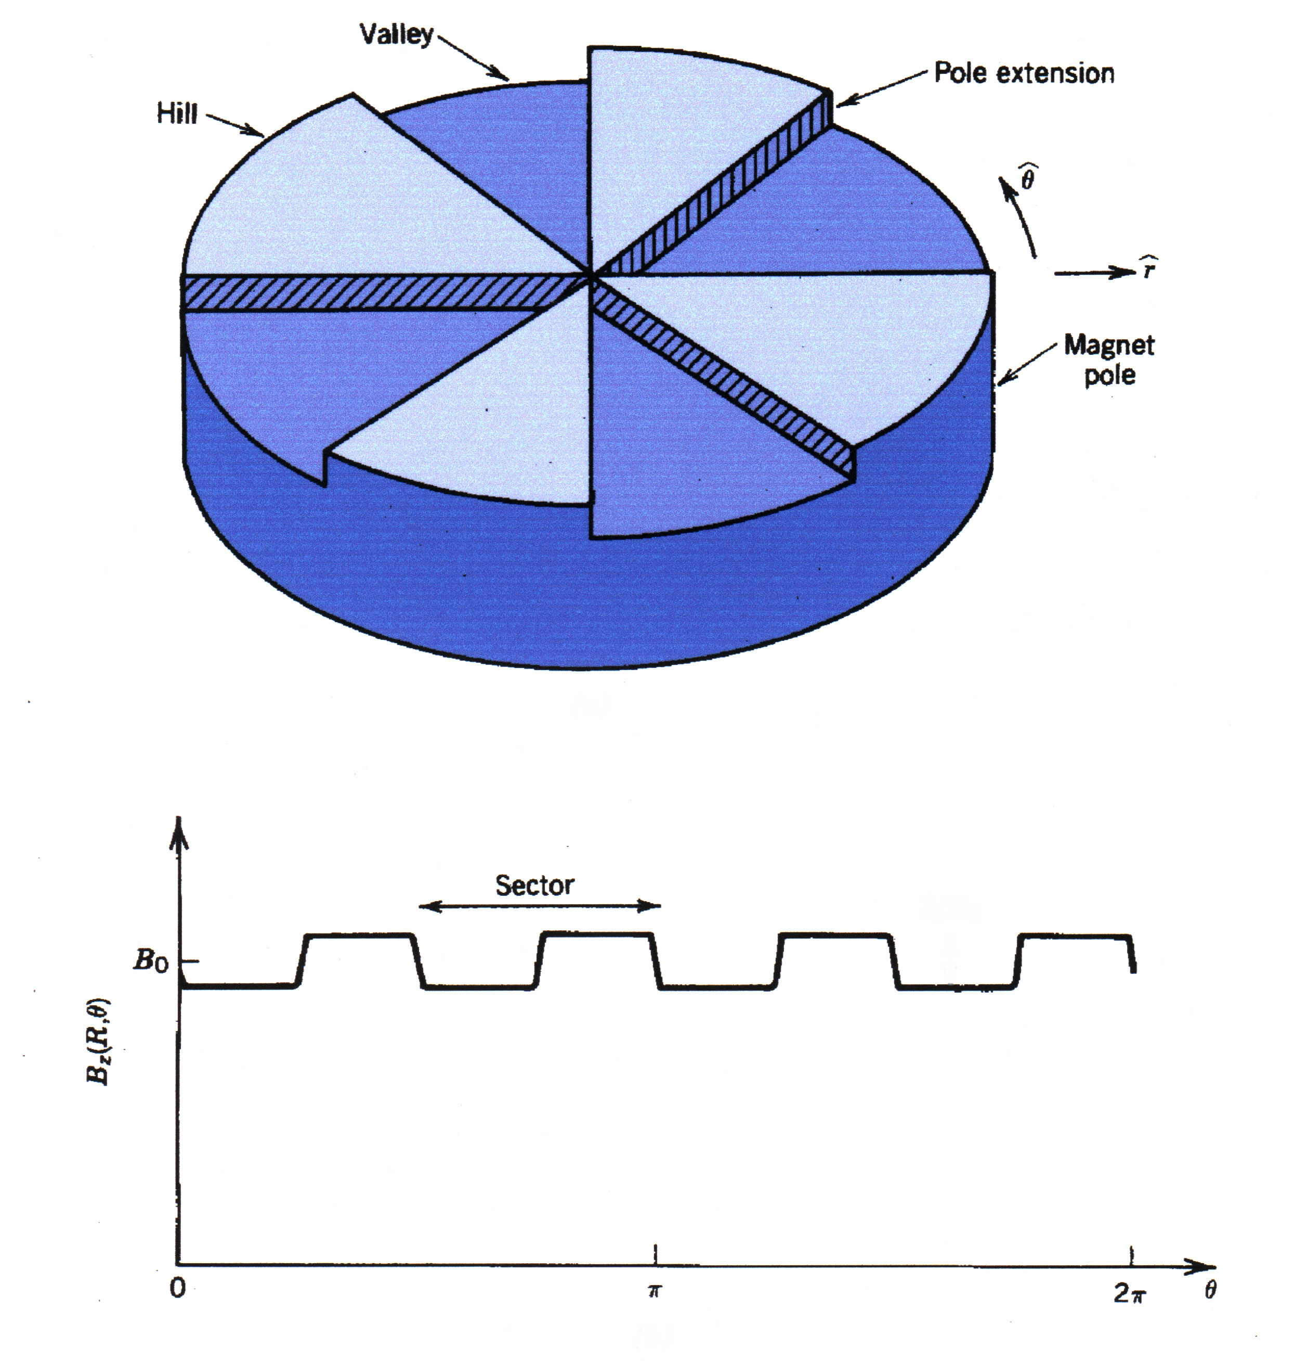
The AVF Cyclotron
Alternating high and low fields provide azimuthal focussing, while at the same time allowing the average field to increase with radius.
Notes:
In the Thomas concept, the cyclotron field is structured with alternating high and low fields. The effect of these varying fields is to provide the focusing needed to keep the particle constrained to the midplane of the magnet gap, while at the same time providing an average field that increases with radius. This increase in average radius is then tailored to match the relativistic mass increase effect and keep the orbit times in synchronization with the fixed rf frequency.
Thus, with this approach, one can accommodate the focusing and relativity requirements while maintaining the classical cyclotron intensities.
The AVF concept resurfaced at a very opportune time. Around 1956, the ORNL Electronuclear Division was preparing a proposal for a new conventional cyclotron. But with these new ideas, it was felt by many that such a machine might become obsolete very quickly.
So, after considerable discussion, it was decided to propose building an AVF type machine. The pole size was retained, but instead of calling it the 76-inch cyclotron, it was decided to name it the Oak Ridge Isochronous Cyclotron, ORIC.

Slide 25
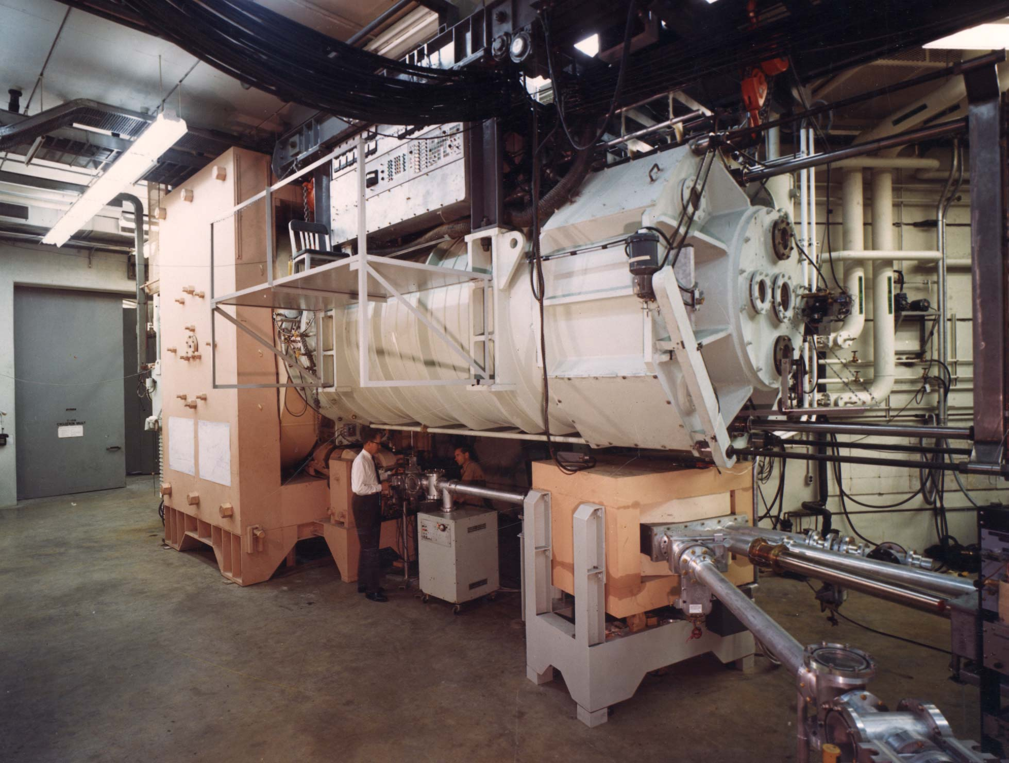
ORIC
Notes:
Once the decision was made to go with an AVF type of design for the proposed new cyclotron, it was decided to develop a design that would accommodate a large variety of accelerated particles over a wide range of energies.
This meant designing and building a complicated RF system that could span a wide range of frequencies and a complex magnet system that could provide the wide range of field shapes that would be required.
The end result will be discussed in the next lecture.

